Slide 1
Diabetes prediction app
User Manual
Saif Rashid

Slide 2
Contents
About myself
Acknowledgements
Experience with clevered
About the app
How to use the app
Contact information

Slide 3
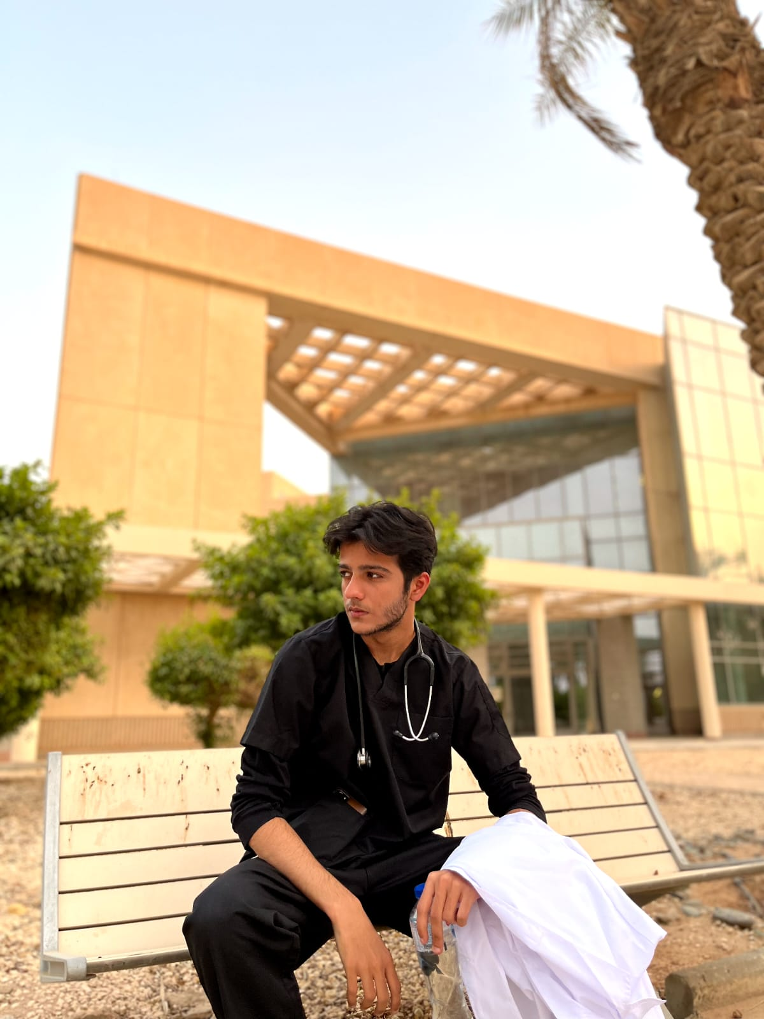
About the author
I’m Saif Rashid, 17. I am a pre-medical student in A2 level. Looking up to my parents, I have always wanted to be a doctor . I have had many athletic, arts and curricular achievements over the last few years. Growing up I have always wanted to help others, especially the ones in need. Pursuing my academic prowess in the medical field and AI/ programming together gives me an optimistic and creative approach to use the knowledge I gain from both, together, for the ease of others and expanding my knowledge.

Slide 4
Acknowledgements
Throughout my journey with clevered, I have learnt a lot over the course of a couple months. It is all due to my father enrolling me in the internship that I was given the chance to learn from enthusiastic and skilled mentors Mr. Avishek and Mr. Kuldeep. I appreciate their efforts and the patience they have had with not just myself but the other students as well.

Slide 5
Experience with Clevered
As a pre-med student, I was doubtful of learning AI as I had no previous background on computer sciences. Beginning the course cleared my doubts quickly thanks to the help of the great teachers Mr. Kuldeep and Mr. Avishek. Learning and proceeding with the internship has been enjoyable and enthusiastic, I have earned rockstar badges for class attentiveness and interaction. I see myself keeping the same attitude towards the learning prowess.
Having the opportunity to learn under a named institute and helpful mentors has been very joyful. It has opened a new door for possibilities, I look forward to the completion of the internship and moving forward with all that I will have learnt.

Slide 6
About the app
The diabetes prediction app.
As the name implies, the app will be used to predict if the user has diabetes. The aim for this app is to start a journey on making app that will extend reach to help those who have limited accessibility to tests or diagnosis. The app uses collected data from Indian hospitals to predict diabetes.

Slide 7
How to use the app
After opening the app, provide correct information within the spaces provides.
Make sure the input is in numerical values and is correct
Note that ;
The pregnancy input is either 1, if the user is currently pregnant, or 0 if not. Naturally, a male user will put 0 as the input.
Most input values should be known but if any are unknown, use average values in case of normal health
Post code if unknown can be found by googling “What is the postcode of where I reside”.
If any queries, contact me on any of the information provided in the next slide.

Slide 8


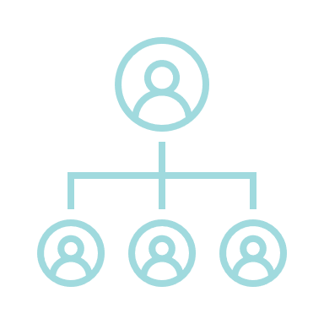
Contact information
Phone/ Whatsapp
Email
+92 340 548 3645
+1 (307) 222-8882
ssaip4196@gmail.com
Socials
Instagram : 33saiff
Twitter : chiefchef00
Discord : chief#7077

